Slide 1

Crop Production Analysis

Slide 2
Introduction:
India is a global leader in agricultural production, boasting the top spot for milk and pulses, and ranking second in rice, wheat, and cotton production worldwide . This translates to a vibrant and diverse agricultural sector, forming the backbone of the Indian economy and providing food security for its vast population.
Beyond the staple food grains of rice and wheat, India cultivates a wide range of crops. From sugarcane, a key ingredient in sugar production, to oilseeds used for cooking oils, the country's agricultural landscape caters to a variety of dietary needs. Fruits, vegetables, and commercial crops like tea and coffee add further depth and economic value
Crop production in India is not a uniform picture. Different regions excel in cultivating specific crops. States like Uttar Pradesh and Madhya Pradesh are major producers, but countless other states contribute significantly to the national agricultural output. Seasonal variations also play a crucial role. The kharif season, corresponding to the summer monsoon, and the rabi season during winter, account for a large portion of crop cultivation.

Slide 3
Details of Data:
State Name: Name of the state where the crop was produced.
District Name: Name of the district within the state where the crop was produced.
Crop Year: The year in which the crop was harvested.
Season: The season in which the crop was grown (e.g., Kharif, Rabi).
Crop: The type of crop grown (e.g., wheat, rice, maize).
Area: The area of land (in hectares or acres) used for growing the crop.
Production: The amount of crop produced (in tons, kilograms, etc.).

Slide 4
Main API’s
Crop wise analysis : Understand production trends, area occupied and variations among different crops.
State wise analysis: Compare crop production across different states.
Seasonal wise analysis: Analyze how crop production varies with different seasons (kharif, rabi, etc.)
Map : Geospatial visualization to show crop production across states or districts.

Slide 5
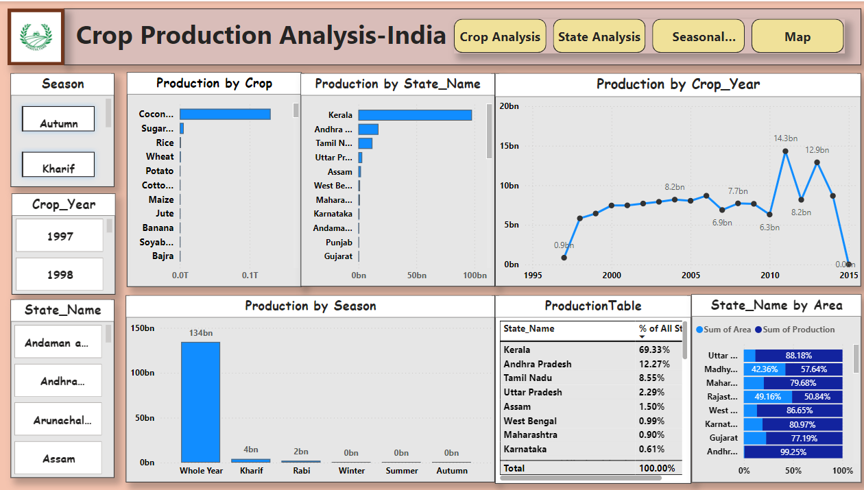
My Dashboard:

Slide 6
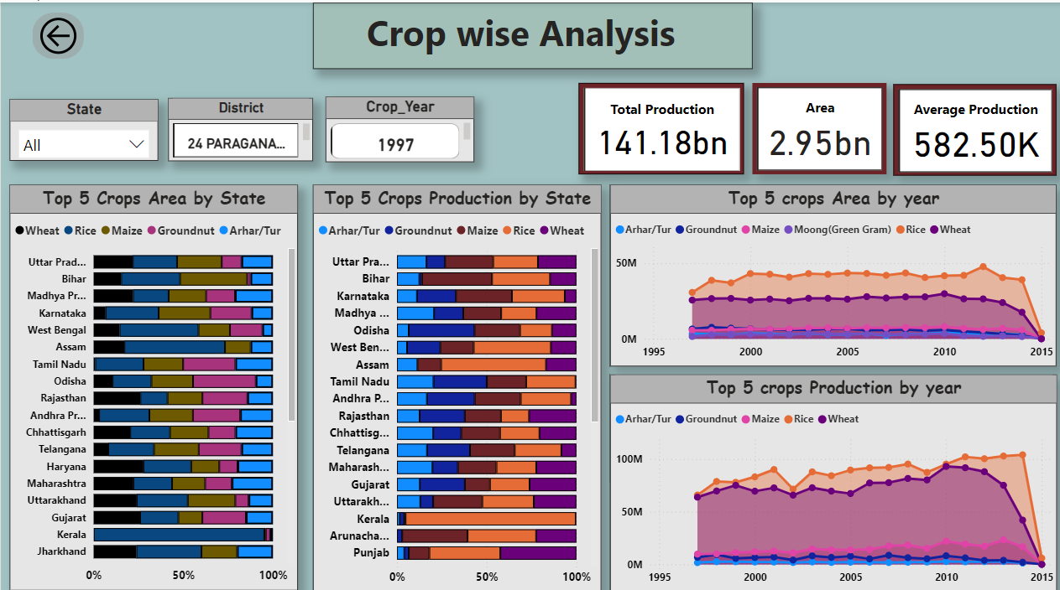
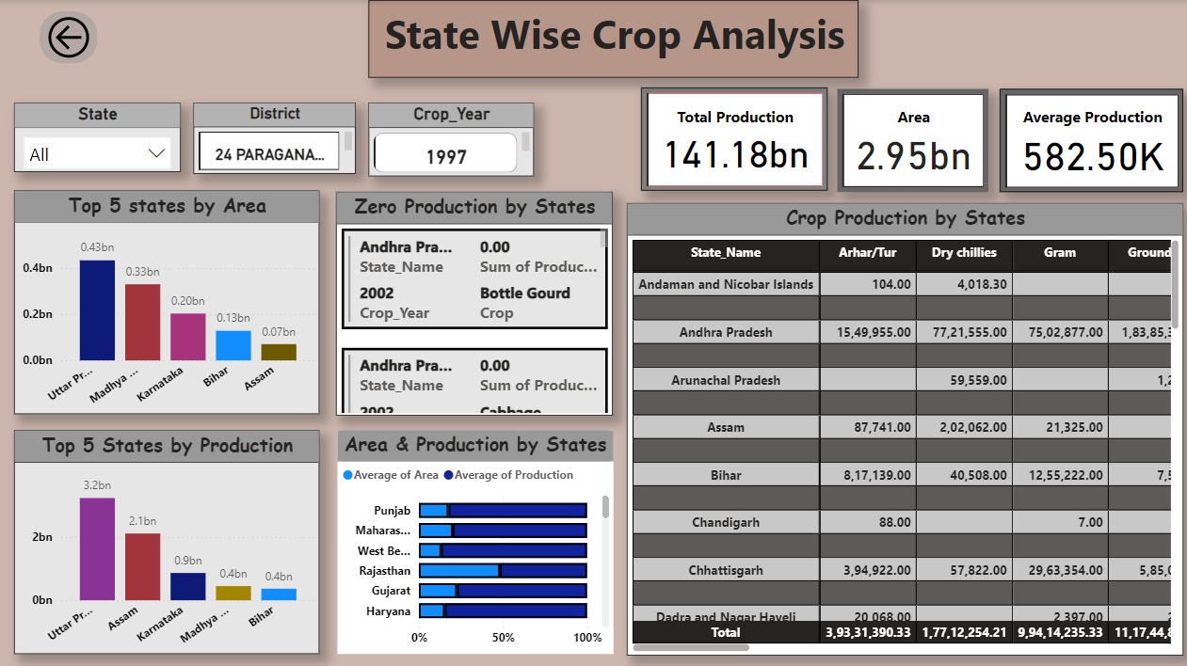
My design:

Slide 7
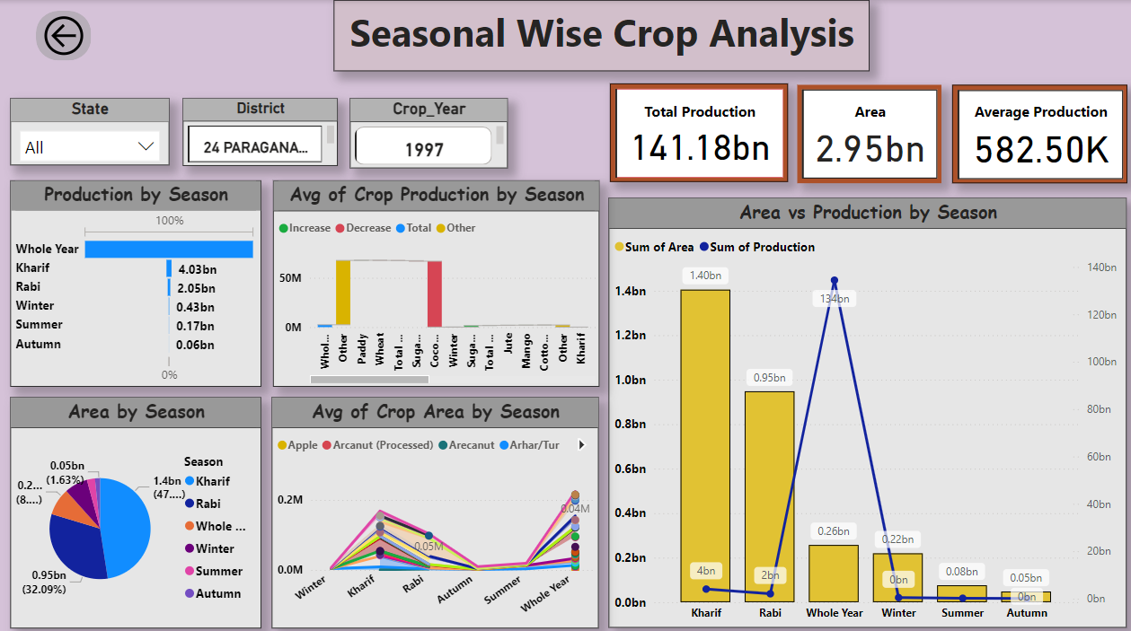
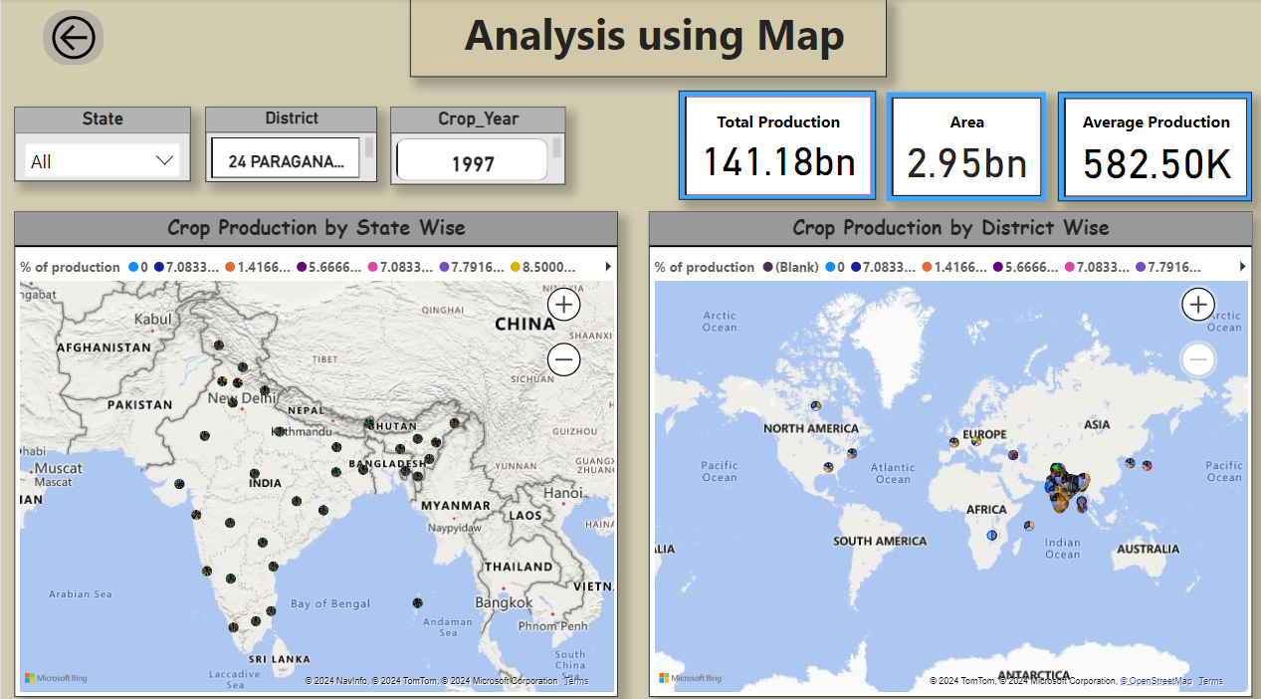

Slide 8
Thank you

